Slide 1




Slide 2




Slide 3
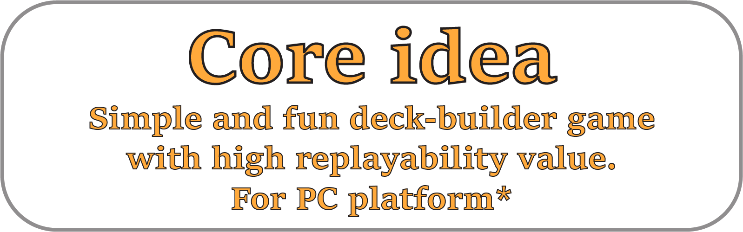

Slide 4
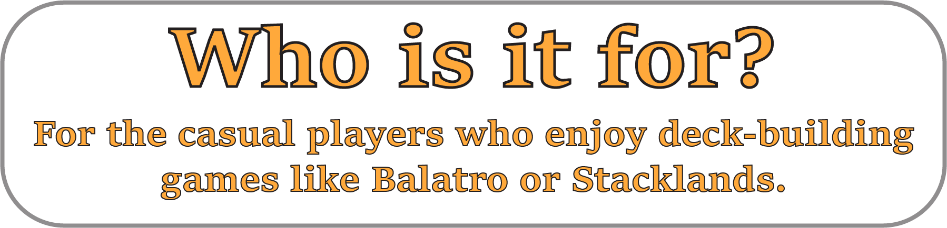

Slide 5


Slide 6


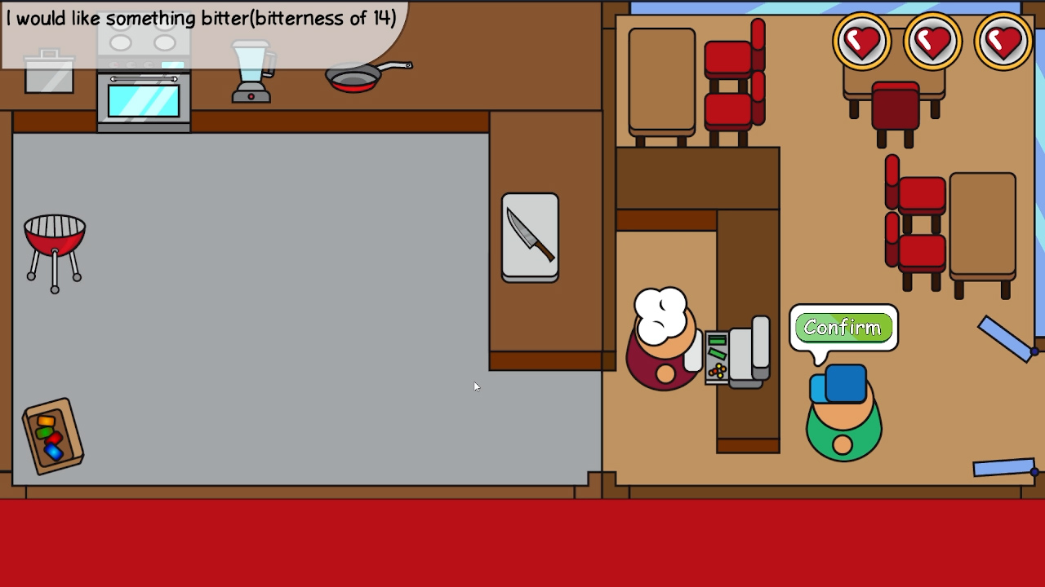
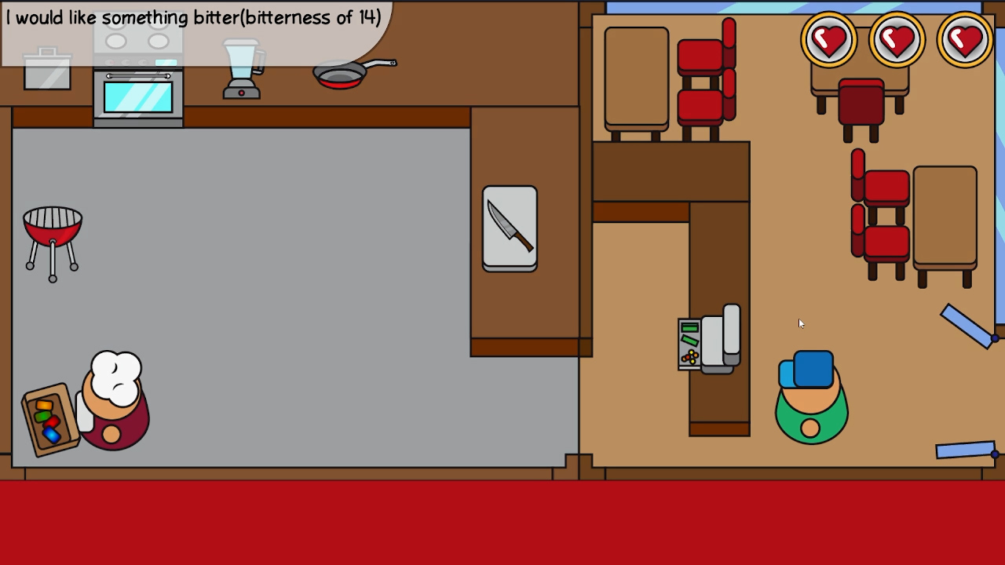

Slide 7



Slide 11


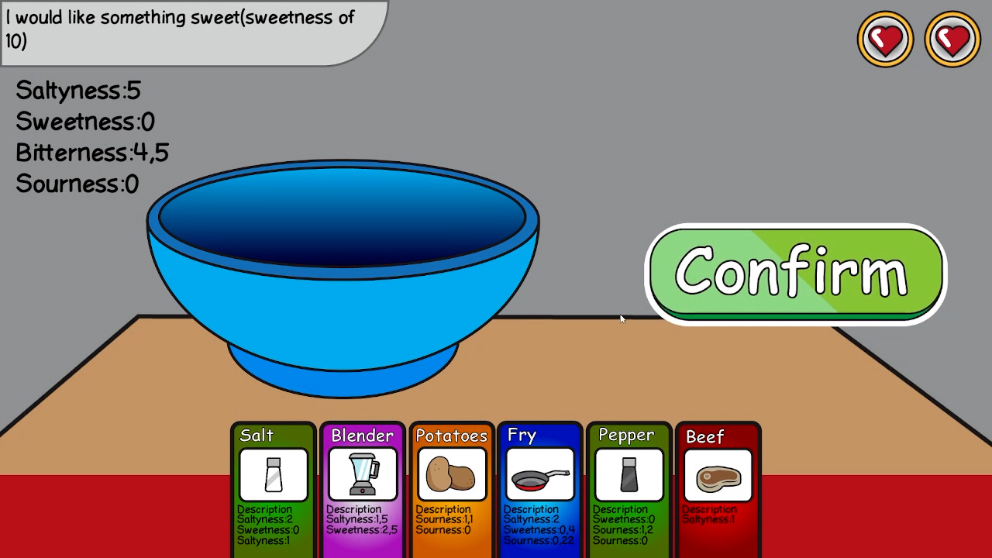
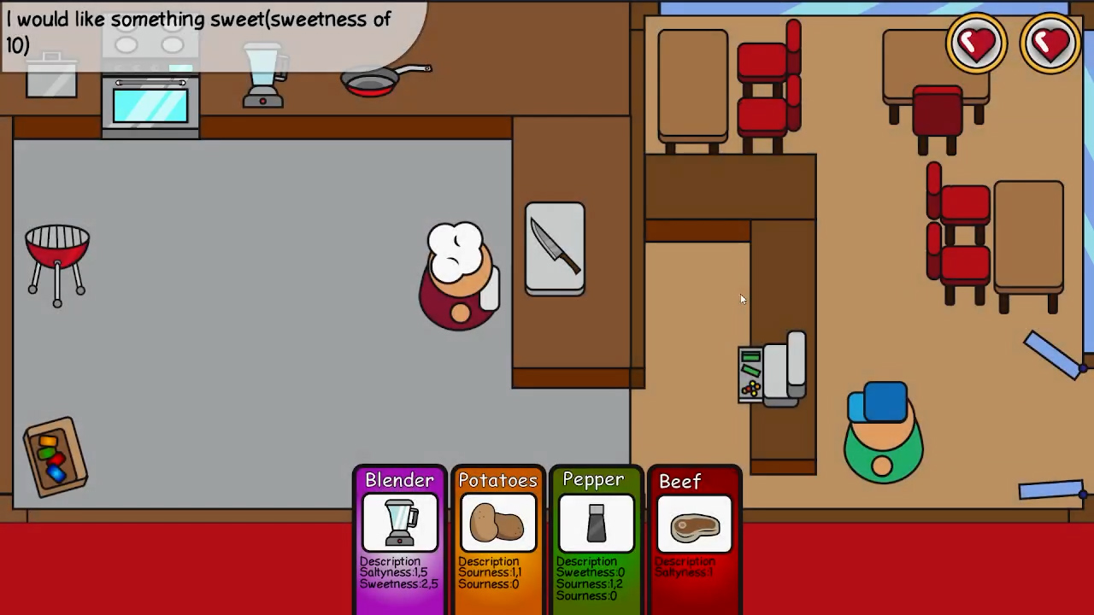

Slide 12


Slide 15

-Randomized cards.
-Simple to learn controls.
-Clear player feedback.
-Simple and understandable graphics.

Slide 16



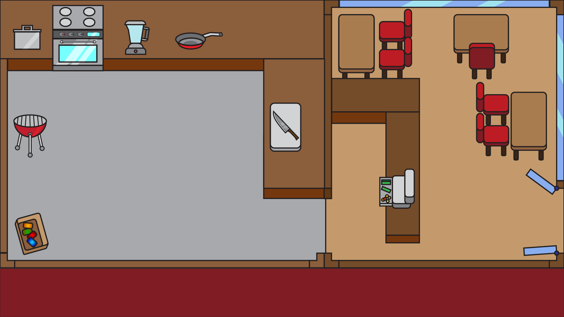




Slide 21

Small replayable casual game.
Developement time of 3 months.
With many code and art assets.

Slide 22

-UI Improvements.
-Better player feedback.
-More card mechanics.
-More cards.

Slide 23
Thank You.

